Slide 1
Sound and Metaphor in Li-Young Lee’s “Persimmons”

Slide 2
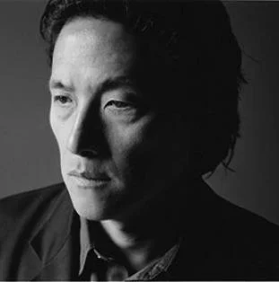
Who is the Poet?
Li-Young Lee was born in 1957 in Jakarta, Indonesia, to Chinese parents. His father had been a personal physician to Mao Zedong while in China, and relocated the family to Indonesia, where he helped found Gamaliel University. In 1959, the Lee family fled the country to escape anti-Chinese sentiment and after a five-year trek through Hong Kong, Macau, and Japan, they settled in the United States in 1964.
Lee attended the University of Pittsburgh and University of Arizona, and the State University of New York at Brockport. He has taught at several universities, including Northwestern and the University of Iowa.
“A poem is like a score for the human voice.” (From poets.org)

Slide 3
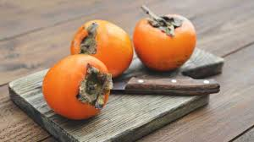
Persimmons by Li-Young Lee
In sixth grade Mrs. Walker
slapped the back of my head
and made me stand in the corner
for not knowing the difference
between persimmon and precision.
How to choose
persimmons. This is precision.
Ripe ones are soft and brown-spotted.
Sniff the bottoms. The sweet one
will be fragrant. How to eat:
put the knife away, lay down newspaper.
Peel the skin tenderly, not to tear the meat.
Chew the skin, suck it,
and swallow. Now, eat
the meat of the fruit,
so sweet,
all of it, to the heart.

Slide 4
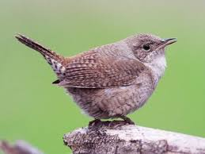
Donna undresses, her stomach is white.
In the yard, dewy and shivering
with crickets, we lie naked,
face-up, face-down.
I teach her Chinese.
Crickets: chiu chiu. Dew: I’ve forgotten.
Naked: I’ve forgotten.
Ni, wo: you and me.
I part her legs,
remember to tell her
she is beautiful as the moon.
Other words
that got me into trouble were
fight and fright, wren and yarn.
Fight was what I did when I was frightened,
Fright was what I felt when I was fighting.
Wrens are small, plain birds,
yarn is what one knits with.
Wrens are soft as yarn.
My mother made birds out of yarn.
I loved to watch her tie the stuff;
a bird, a rabbit, a wee man.

Slide 5
Mrs. Walker brought a persimmon to class
and cut it up
so everyone could taste
a Chinese apple. Knowing
it wasn’t ripe or sweet, I didn’t eat
but watched the other faces.
My mother said every persimmon has a sun
inside, something golden, glowing,
warm as my face.
Once, in the cellar, I found two wrapped in newspaper,
forgotten and not yet ripe.
I took them and set both on my bedroom windowsill,
where each morning a cardinal
sang, The sun, the sun.

Slide 6
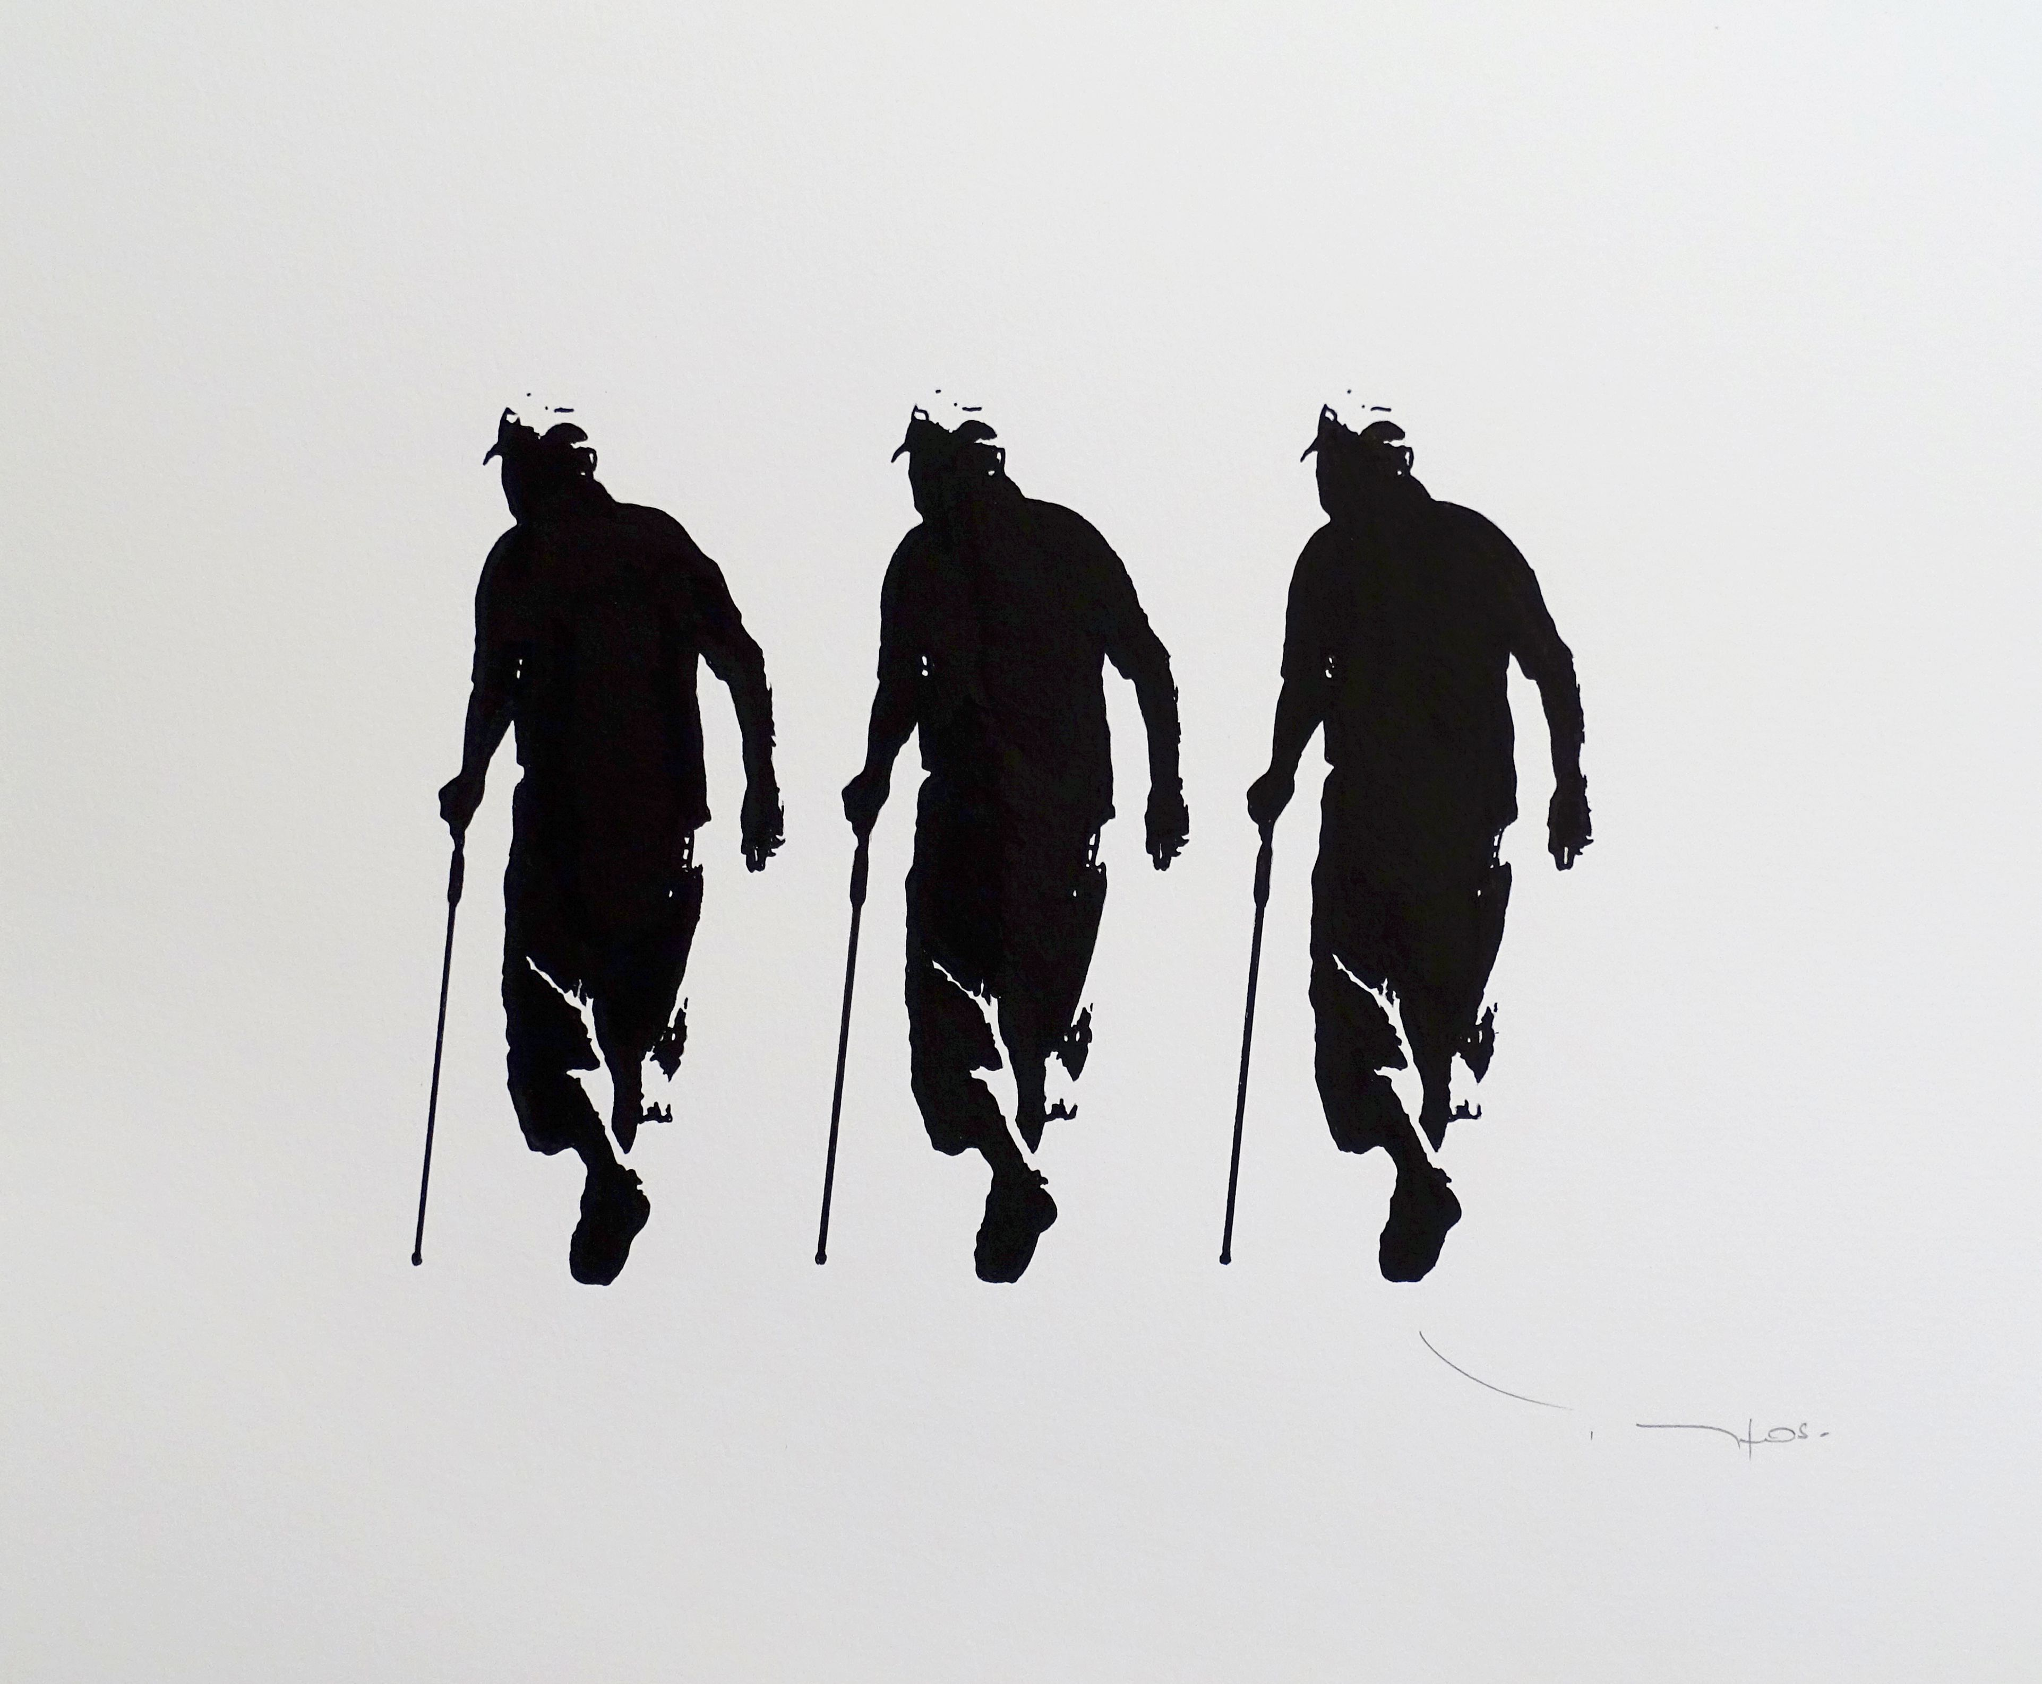
Finally understanding
he was going blind,
my father sat up all one night
waiting for a song, a ghost.
I gave him the persimmons,
swelled, heavy as sadness,
and sweet as love.
This year, in the muddy lighting
of my parents’ cellar, I rummage, looking
for something I lost.
My father sits on the tired, wooden stairs,
black cane between his knees,
hand over hand, gripping the handle.
He’s so happy that I’ve come home.
I ask how his eyes are, a stupid question.
All gone, he answers.

Slide 7
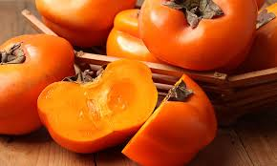
Under some blankets, I find a box.
Inside the box I find three scrolls.
I sit beside him and untie
three paintings by my father:
Hibiscus leaf and a white flower.
Two cats preening.
Two persimmons, so full they want to drop from the cloth.
He raises both hands to touch the cloth,
asks, Which is this?
This is persimmons, Father.
Oh, the feel of the wolftail on the silk,
the strength, the tense
precision in the wrist.
I painted them hundreds of times
eyes closed. These I painted blind.
Some things never leave a person:
scent of the hair of one you love,
the texture of persimmons,
in your palm, the ripe weight.

Slide 8
Annotated Excerpts
In sixth grade Mrs. Walker
slapped the back of my head
and made me stand in the corner
for not knowing the difference
between persimmon and precision.
How to choose
persimmons. This is precision.
Ripe ones are soft and brown-spotted. Sniff the bottoms. The sweet one
will be fragrant. How to eat:
put the knife away, lay down newspaper.
Peel the skin tenderly, not to tear the meat.
Chew the skin, suck it,
and swallow. Now, eat
the meat of the fruit,
so sweet,
all of it, to the heart.
“P” alliteration, short “I” assonance, “S” consonance, connecting and emphasizing the importance of care and diligence in
preparing a persimmon and proper pronunciation.
Sensory details (see, smell, taste, feel) increase the visceral intensity of the event and introduce the imagery of sexual intimacy.
Personification

Slide 9
Mrs. Walker brought a persimmon to class
and cut it up
so everyone could taste
a Chinese apple. Knowing
it wasn’t ripe or sweet, I didn’t eat
but watched the other faces.
My mother said every persimmon has a sun
inside, something golden, glowing,
warm as my face.
Once, in the cellar, I found two wrapped in newspaper
forgotten and not yet ripe.
I took them and set both on my bedroom windowsill,
where each morning a cardinal
sang, The sun, the sun.
Here is sensory detail again.
“S” consonance throughout this stanza, echoed with “sang” and “sun” alliteration at end of stanza brings a soft, comforting feeling to image of this fruit, connected to home.
Long “O” and hard “G” sound slow line for impact and deeper sound to emphasize richness.
Simile of warmth and light connects to comfort of home reflected in speaker’s appearance.
Hearing (also onomatopoeia)

Slide 10
Finally understanding
he was going blind,
my father sat up all one night waiting for a song, a ghost. I gave him the persimmons, swelled, heavy as sadness, and sweet as love.
Metaphor: The persimmons are the ghost. They’re the memory of something that’s been lost to his father; he’ll never see persimmons again.
The alliterated sound ties together the signficance of the fruit (swelled, full), the sadness of what’s been lost in this moment, and the sweetness of what he once had. It’s nostalgic.

Slide 11
Under some blankets, I find a box.
Inside the box I find three scrolls.
I sit beside him and untie
three paintings by my father:
Hibiscus leaf and a white flower.
Two cats preening.
Two persimmons, so full they want to drop from the cloth.
He raises both hands to touch the cloth, asks, Which is this?
This is persimmons, Father.
Oh, the feel of the wolftail on the silk, the strength, the tense
precision in the wrist.
I painted them hundreds of times
eyes closed. These I painted blind.
Some things never leave a person:
scent of the hair of one you love,
the texture of persimmons,
in your palm, the ripe weight.
Personification - persimmons more like an
animal or human to make them feel more alive (having agency) in speaker’s memory.
“f” followed by “s” consonance creates a
sibilance to mimic the sound and soft care of brushstrokes and the tender way the paintings connect speaker to father.
Onomatopoeic (?) effect of long vowels giving heavier sound or “weight” to the emotional weight of persimmons.

Slide 12
Two Possible Theses
In the poem “Persimmons,” Li-Young Lee reveals a complicated relationship between the speaker and a native Chinese fruit. By anthropomorphizing the fruit and describing both eating and painting persimmons with soft assonance and consonance, the author emphasizes both how provocative and familial the speaker’s deep love is for this fruit. Ni, wo: you, me. Self and other. Myself and the thing I have taken time to cherish, neither of which will last forever. In his poem “Persimmons,” Li-Young Lee addresses the way he learned words and how he came to understand the world around him more generally. What he is really talking about, though, is love. If we pay attention carefully, he says--if we look, listen, smell, taste, and feel—then we are learning the things we love by heart. After such study, however transitory they may be, we cannot lose them.

