Slide 1
Pride and Prejudice
Jane Austen
1813

Slide 2
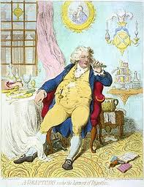
Regency England—1811-1820
George IV Prince Regent
Napoleonic Wars w/ France—1803-1815
Everyday English life, esp. among upper classes, largely untouched
Most characters in P&P are not aristocracy, but gentry

Slide 3
Landed Gentry
A class of people wealthy enough to live off the interest generated by their property and the rent paid by tenants on their land.
They are not nobility—the majority do not have titles.
Go here for a thorough (if obnoxious) definition: https://www.youtube.com/watch?v=9m1mYNPVBEE

Slide 4
Literary Periods
Enlightenment (much of 1700s)—rationality, satire, social concerns
Romantic (approx. 1789-1850)—emotion, authenticity, individuality, distrust of conventional social mores
Victorian and Edwardian (mid 1800s-1918)—social responsibility
Modern (1918-approx. 1950)—authenticity, distrust of conventional social mores, doubt about our ability to know things

Slide 5
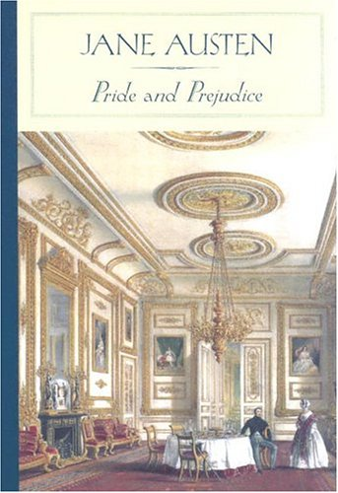
BUT
Novel of Manners—
the conventions of society dominate the story
-Is this a novel of manners or a satire of a novel of manners?
-Is it Romantic or aristocratic Regency?
-That is, does it ultimately question or reinforce society’s values?

Slide 6
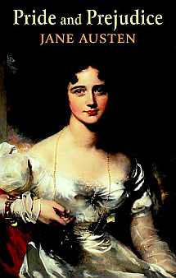
=
AND ON THAT NOTE…
?

Slide 7
But suck it up, manly men…

Slide 8
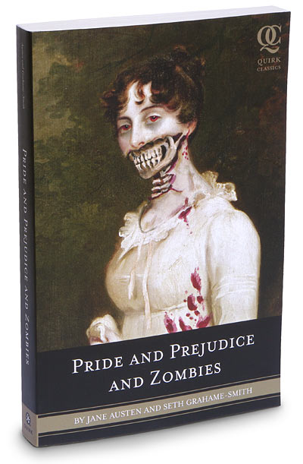
Style, etc.
Originally published in three “books” (i.e. three parts), as were most novels of the day
Mostly Lizzy’s thoughts (seems to be limited third person POV)
BUT others’ perspectives come into play (really omniscient third person POV)
MUCH MORE ON NARRATIVE VOICE LATER
Stylin’…

Slide 9
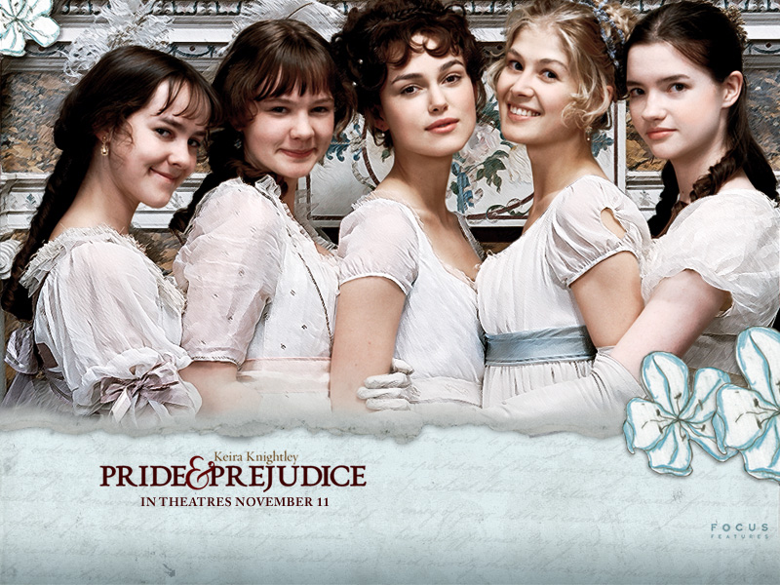
Bennet Girls’ Ages
Jane – 22
Elizabeth (Lizzy, Eliza) – 20
Mary – ?
Catherine (Kitty) – 17
Lydia – 15

Slide 10
Opening Passage
It is a truth universally acknowledged, that a single man in possession of a good fortune, must be in want of a wife.
However little known the feelings or views of such a man may be on his first entering a neighbourhood, this truth is so well fixed in the minds of the surrounding families, that he is considered the rightful property of some one or other of their daughters.
"My dear Mr. Bennet," said his lady to him one day, "have you heard that Netherfield Park is let at last?"
Mr. Bennet replied that he had not.
"But it is," returned she; "for Mrs. Long has just been here, and she told me all about it."
Mr. Bennet made no answer.

Slide 11
Free Indirect Speech/Discourse
Speech of character is reported by narrator rather than quoted—i.e. REPORTED SPEECH OR THOUGHT
Subtle clues in language indicate character’s view of the situation
Narrator may share or judge the character’s view

Slide 12
Direct speech: He looked over at his wife. “She looks so unhappy,” he thought, “almost sick.” He wondered what to say.
Indirect speech: He looked over at his wife. She looked so unhappy, he thought, almost sick. He wondered what to say.
Free indirect speech (character’s voice creeps in): He looked at his wife. Yes, she was tiresomely unhappy again, almost sick. What the hell should he say?

Slide 13
Free Indirect Discourse/Speech in Pride and Prejudice
Mr. Bennet could not have chosen better. Mr. Collins was eloquent in her praise. The subject elevated him to more than usual solemnity of manner, and with a most important aspect he protested that he had never in his life witnessed such behaviour in a person of rank—such affability and condescension as he had himself experienced from Lady Catherine. She had been graciously pleased to approve of both the discourses, which he had already had the honour of preaching before her. She had also asked him twice to dine at Rosings, and had sent for him only the Saturday before to make up her pool of quadrille in the evening. Lady Catherine was reckoned proud of many people he knew, but he had never seen anything but affability in her. She had always spoken to him as she would to any other gentleman; she made not the smallest objection to his joining in the society of the neighbourhood, nor to his leaving his parish occasionally for a week or two to visit his relations. She had even condescended to advice him to marry as soon as he could, provided he chose with discretion; and had once paid him a visit in his humble parsonage, where she had perfectly approved all the alternations he had been making, and had even vouchsafed to suggest some herself—some shelves in the closets upstairs.
Ch, 14, p. 53

Slide 14
Lady Catherine looked in my upstairs closet, and she totally approved of this!

