Slide 1
The Woman Warrior and Things Fall Apart
an overview

Slide 2
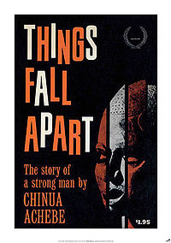
Things Fall Apart
By Chinua Achebe
Nigerian
Written in 1958.
Set in the 1890s, with the arrival of the first Europeans among the Igbo people.
Brilliantly constructed. Recipient of Nigerian National Merit Award. Received international critical acclaim.

Slide 3
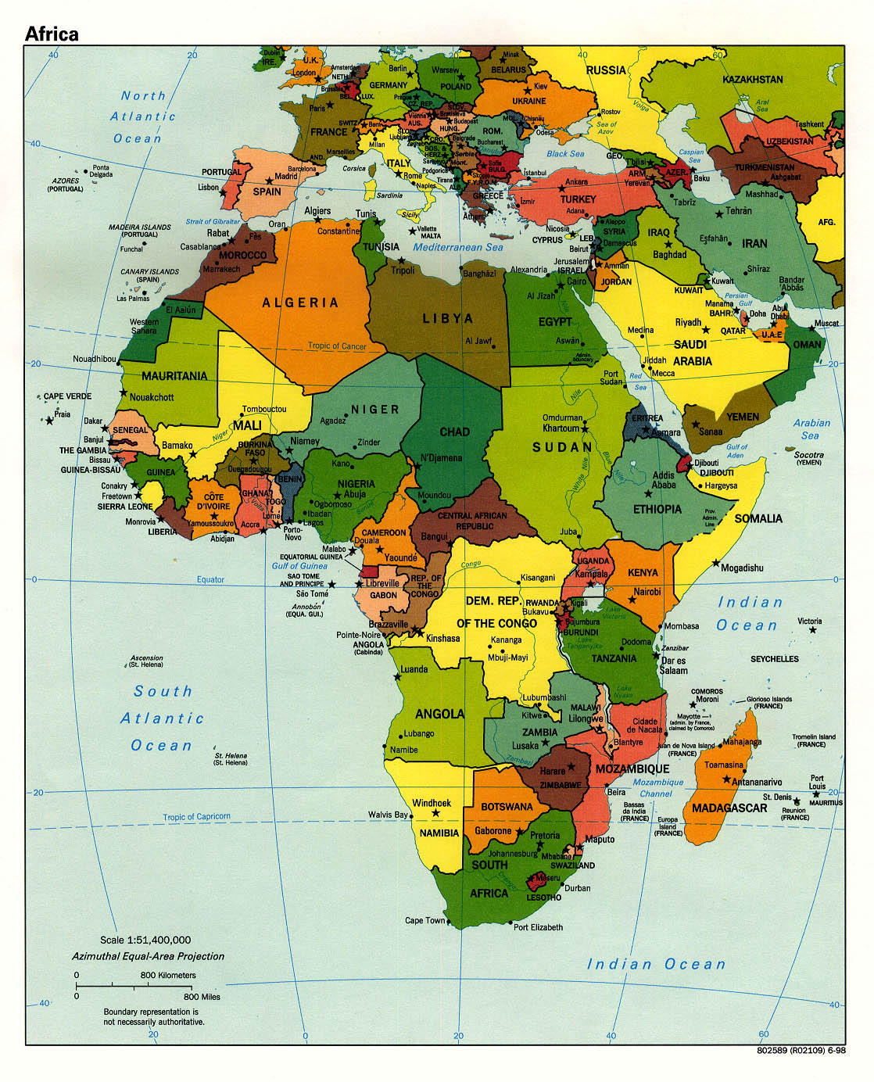
Nigeria
A creation of European colonialism.
Two major ethnic groups / nations-- The Igbo (Ibo) and the Yoruba—and a host of smaller groups.
Colonized mainly by the British.
Contemporary times: One of the most prosperous African nations.
Prosperity = GDP, not equal distribution of wealth.

Slide 4
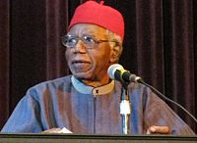
TFA—The Language
-ORAL TRADITION (Igbo—no
pre-European written tradition.)
-English Why? Who is the audience? What is the book’s goal?
-Captures patterns of Igbo speech and spirit of the language in the words, phrases, folk tales, proverbs
Proverbs and storytelling play an irreplaceable role in Ibgo culture, even now.
(Social glue. Ties together religion, social class, philosophy, history, family structure.)

Slide 5
TFA—style and themes
Simple language, complex ideas and structure.
Structured as a traditional Greek tragedy.
Thematic stuff to watch for:
Male power vs. female power (massively complex)
Where Okonkwo reinforces his culture and where he rejects his culture
Defamiliarization vs. making the strange familiar—who is this story for? What is its goal?
Collisions between cultures—where and why do disagreements happen? IS one culture “bad” and in need of reforming? (If so, in what respect?)

Slide 6
An excerpt from Things Fall Apart
p.

Slide 7
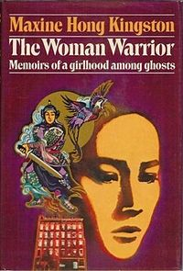
The Woman Warrior
By Maxine Hong Kingston
Second-generation immigrant from China (grows up in California).
Written in 1975.
Semi-autobiographical—the author struggles to be female, Chinese, and American at the same time.

Slide 8
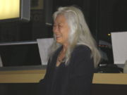
WW--Honors
Modern Language
Association’s most
commonly taught text in
modern university education (American lit.,
anthropology, Asian studies, composition,
education, psychology, sociology, women's
studies…
Kingston teaches at UC Berkeley

Slide 9
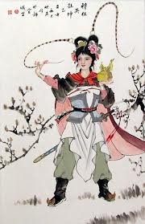
Allegory
Fa Mu Lan myth (ancient
female warrior who brings
justice to China)
=
allegory for modern-day
struggles w/ gender and
ethnicity.
“[ My mother] said I would grow up a wife and a slave, but she taught me the song of the warrior woman, Fa Mu Lan. I would have to grow up a warrior woman.”

Slide 10
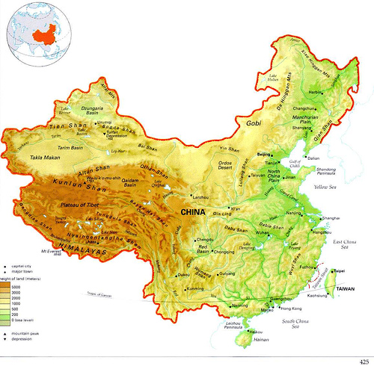
Style
Rich in allegory, motif, and symbolism.
Humor or anger? Yes.
Neither a comedy nor a tragedy

Slide 11
Further Thematic Stuff
Speech as power: “Slaves” have no speech. Language is a weapon.
Girlhood: “Girls are a waste of food.”
Cultural assimilation: What is valuable or problematic in Chinese culture? American culture? Are the stories we tell about our cultures real representations, or altered? How does a culture “haunt” us?
The main character’s difficult relationship with her powerful mother.

Slide 12
An excerpt from The Woman Warrior
p. 19-20, 45-47

Slide 13
Both novels:
Written in post-colonial/post-World War II era, multi-cultural literature.
Reflect back on tribal/primitive beliefs of Nigerian or Chinese culture. Hallowed belief or silly superstition?
Both value “war,” or at least the violent fight for pride and/or justice.
Importance of storytelling in defining yourself, your family, and your culture. Considering your own story.

