Slide 1
W;t
by Margaret Edson
(Pulitzer prize for drama in 1990)

Slide 2
Edson’s background
Professor of English? (Georgetown University)
Nah, kindergarten teacher (you’ll see why).
Her thesis project, on the use of poetry to teach reading, concluded with an oral defense in which Edson performed a Queen Latifa rap number before her faculty review panel.

Slide 3
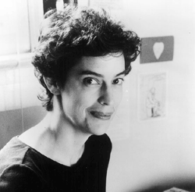
"It's so corny, but if there's a world that I want to see that has more justice in it, teaching is the way for me to bring that about," she explains. "Reading and writing is power--the thing that gives you the most power in your whole life. I like being part of students acquiring that power. I like handing that power over."

Slide 4
Ovarian Cancer
No reliable screening.
Epithelial cell tumors (the kind Vivian Bearing has) develop in the cells that cover the surface of the ovaries.
90% of ovarian cancers.
Treatment=removal of all affected reproductive organs + chemotherapy.

Slide 5
Severity of a cancer = 1 to 4
Stage 4 cancers have spread (metastasized) to distant organs, and are therefore much more difficult to treat.
Only 15% of ovarian cancers in the U.S. are diagnosed at the early stages.
Five-year survival rate for women with ovarian cancers in stages 1 to 4 = 47%.
For women diagnosed at the advanced stages = 28%.

Slide 6
Aristotle’s Explanation of Tragedy
Hamartia – the tragic hero’s flaw or mistake
Peripeteia – reversal of fortune
Anagnorisis – the tragic hero’s recognition (of tragic flaw)
Catharsis – audience realization and expression of emotions generated by literature that relate to their lives—leads to purging of emotion / emotional purification

